Slide 1
Linear Regression
By Madhur Jain

Slide 2
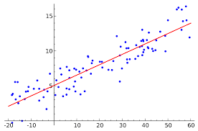
Linear Regression
Linear regression shows the relationship between two variables.
Input Variable: Independent variables / Explanatory variables or Features keeping on X axis .
Output Variable: Dependent variable/predictor or Response variable the factor of interest keeping on Y axis.
For e.g. sales of a product, pricing, performance, risk etc.
Dependent Variable (Y)
Independent Variable (X)

Slide 3
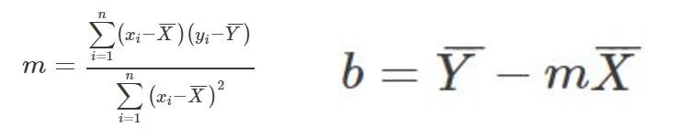
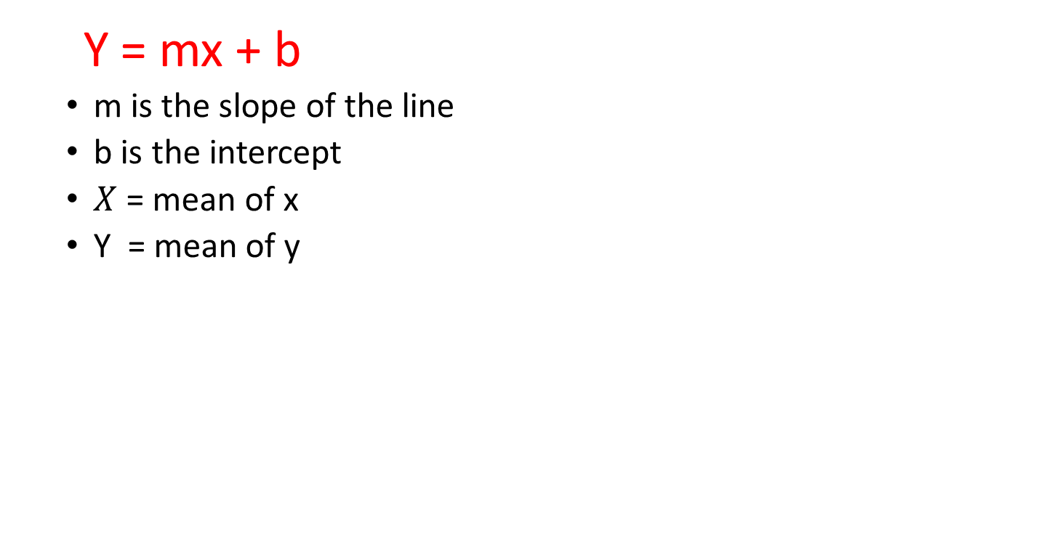
Linear regression formula’s
Y = mx + b
m is the slope of the line
b is the intercept
$X$ = mean of x
Y = mean of y

Slide 4
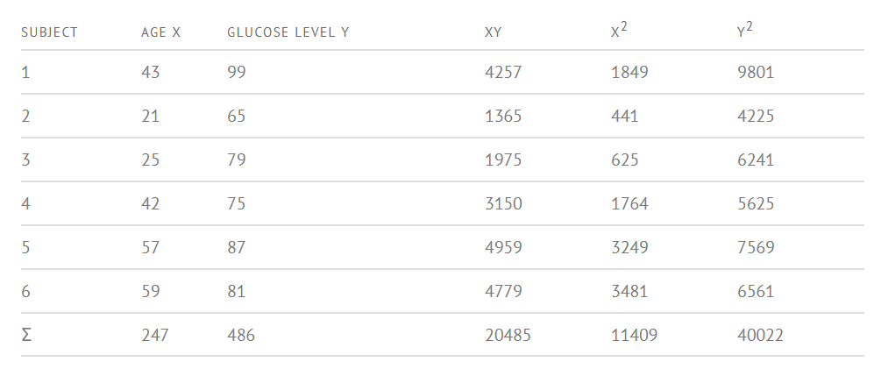
How to Find a Linear Regression Equation
Step 1: Make a chart of your data, filling in the columns in the same way as you would fill in the chart if you were finding the Pearson’s Correlation Coefficient.

Slide 5

How to Find a Linear Regression Equation
Step 2: Use the following equations to find a and b.
Find a:
=((486 × 11,409) – ((247 × 20,485)) / 6 (11,409) – 247²)
=484979 / 7445
=65.14
Find b:
=(6(20,485) – (247 × 486)) / (6 (11409) – 247²)
=(122,910 – 120,042) / 68,454 – 247²
=2,868 / 7,445
= .385225
Step 3: Insert the values into the equation.
y’ = a + bx y’ = 65.14 + .385225x

Slide 6
Linear regression for multiple variables
y = θ0+θ1*X → b+mX → Simple LR → Single variable LR
y= θ0+θ1*x1+θ2*x2+..θn*xn → Multiple LR → Multi variable LR

Slide 7

Multiple Regression

Slide 8
Applications of Linear Regression
Evaluate trends and make estimates or forecasts.
For example, if a company’s sales have increased steadily every month for the past few years, by conducting a linear analysis on the sales data with monthly sales, the company could forecast sales in future months.
Analyze the marketing effectiveness, pricing and promotions on sales of a product.
if company XYZ, wants to know if the funds that they have invested in marketing a particular brand has given them substantial return on investment, they can use linear regression.
Linear Regression can be also used to assess risk in financial services or insurance domain.
For example, a car insurance company might conduct a linear regression to come up with a suggested premium table using predicted claims to Insured Declared Value ratio. The risk can be assessed based on the attributes of the car, driver information or demographics. The results of such an analysis might guide important business decisions.

